Slide 1

Agenda
Interfaces
Exception Handling Java.lang package Java.util package
By Bimal Padhy
Github Url
https://github.com/bimalpadhy-ctl/Java_Intern_2024

Slide 2
Interfaces

Slide 3
Contents :
Introduction to interfaces
Syntax
Why Interface?
Extending Interface
Default Methods

Slide 4
Interfaces
• Helps to achieve multiple implementations
• Pure abstract class (can’t be instantiated).
• Can have abstract methods, default methods, static methods.
• Variables are public static final by default
• Interfaces must be implemented by classes to give functionality to the methods

Slide 5
Syntax
interface interfacename
{ // public static final variables
// abstract methods
// default methods
//static methods
}
interface flyable
{
int v = 100;
void fly();
default void check(){ }
}

Slide 6
interface Flyable
{ void fly();}
class Man implements Flyable
{
public void fly()
{
System.out.println(“in planes”);
}
}
class Plane implements Flyable
{
public void fly()
{ System.out.println (“using engines”);
} }

Slide 7
Calling methods on interfaces
• The implementation classes are hidden from the user and the methods are called using interface reference.
Flyable ref = new Man();
ref.fly();
ref = new Plane();
ref.fly();

Slide 8
More on interfaces
• Using interfaces abstraction is achieved.
• Gives scope for extension in future
• A class can implement multiple interfaces
• An interface can extend another interface.
• An interface without methods is called Marker or Tag interface (eg. Serializable, Cloneable)
• An interface with only one abstract method is called as Functional Interface

Slide 9
Why interfaces?
• Multiple classes can implement an interface to come under a common category
class Person implements Flyable
{ public void fly(){
print(“in planes”);
}
class Plane implements Flyable{ public void fly(){ print(“using engines”); }
class Bird implements Flyable{ public void fly(){ print(“using wings”); }

Slide 10
Extending Interfaces
interface Calculator {
void calculate(int x, int y){ }
}
interface Scientific extends Calculator
{ void square(int x){ } }
class AdvCalc implements Scientific
{
void calculate(int x, int y){ }
void square(int x, int y){ }
}

Slide 11
Default Methods
• helps to add new functionality to the existing interfaces of the application
• Adding a default method to an existing interface does not break the contract
• default methods are implicitly public
• Helps to add a common behavior across all implementing classes of the interface
public interface MyInterface
{ // regular interface methods
public void caller();
default void defaultMethod()
{
// default method implementation
}
}

Slide 12
public interface Vehicle {
String getBrand();
String speedUp();
String slowDown();
default String turnAlarmOn()
{ return "Turning the vehicle alarm on."; }
}
public class Car implements Vehicle
{
private String brand; // constructors/getters
@Override
public String getBrand()
{ return brand; }
@Override
public String speedUp()
{ return "The car is speeding up."; }
@Override
public String slowDown() { return "The car is slowing down."; } }

Slide 13
public static void main(String[] args) {
Vehicle car = new Car("BMW");
System.out.println(car.getBrand());
System.out.println(car.speedUp());
System.out.println(car.slowDown());
System.out.println(car.turnAlarmOn());
System.out.println(car.turnAlarmOff());
}

Slide 14
Static Interface Methods
Static Methods are defined in the interface with the keyword static.
These static methods contain the complete definition of the function.
These methods cannot be overridden or changed in the implementation class
interface NewInterface {
// static method
static void hello()
{
System.out.println("Hello, New Static Method Here");
}
// Public and abstract method of Interface
void overrideMethod(String str);
}
/

Slide 15
/ Implementation Class
public class InterfaceDemo implements NewInterface {
public static void main(String[] args)
{
InterfaceDemo interfaceDemo = new InterfaceDemo();
// Calling the static method of interface
NewInterface.hello();
// Calling the abstract method of interface
interfaceDemo.overrideMethod("Hello, Override Method here");
}
// Implementing interface method
@Override
public void overrideMethod(String str)
{
System.out.println(str);
}
}

Slide 16
Lambda Expressions

Slide 17
Contents
• Overview of Functional Interface
• Example
• Lambda Expressions
• Method References

Slide 18
Functional Interface
• An interface with only one abstract method - Functional Interface
• May or may not be annotated with @FunctionalInterface
Few Examples of Functional Interfaces
• Runnable
• Comparable
• Comparator
• Function
• Predicate
• Consumer
• Supplier

Slide 19
Functional Interfaces
The java.util.function package has 8 functional interfaces.
• Function
• BiFunction
• Consumer
• BiConsumer
• Supplier
• BiSupplier
• Predicate
• BiPredicate

Slide 20
Lambda Expressions
• Is defined as a method without name, access specifier, return type.
• Make the code writing simple, short and readable
. • Short way to write the method in the same place where it will be used.
• Used with functional interfaces.
eg.
public int add(int x, int y){ return x+y; }
Using Lambda
(int x, int y) -> { return x+y; }

Slide 21
Syntax
(parameter) -> expression (parameters) -> {statements};
()->expression (arg1, arg2 . . . ) -> { body } (type1 arg1, type2 arg2 . . .) -> { body } (
(int a, int b ) -> { return a+b; }
() -> System.out.println ( “Hello World”);
(String S ) -> { System.out.println (s) ; }
(a,b) -> { return a+b} ;

Slide 22
Example
interface Addable{
int add(int a,int b);
}
public class LambdaExpressionExample{
public static void main(String[] args) {
// Multiple parameters in lambda expression
Addable ad1=(a,b)->(a+b);
System.out.println(ad1.add(10,20));
// Multiple parameters with data type in lambda expression
Addable ad2=(int a,int b)->(a+b);
System.out.println(ad2.add(100,200));
}
}

Slide 23
Java Method References
Method reference is used to refer method of functional interface.
Syntax: ContainingClass::staticMethodName
Types of Method References
There are following types of method references in java:
Reference to a static method.
Reference to an instance method.
Reference to a constructor.

Slide 24
import java.util.Arrays;
import java.util.List;
import java.util.function.Consumer;
public class MethodReference1
{
public static void main(String[] args)
{ List list = Arrays.asList("A", "B", "C");
// anonymous class
list.forEach(new Consumer()
{ @Override public void accept(String x)
{ SimplePrinter.print(x); } });
// lambda expression
list.forEach(x -> SimplePrinter.print(x));
// method reference
list.forEach(SimplePrinter::print);
} }
class SimplePrinter
{ public static void print(String str)
{ System.out.println(str);
} }

Slide 25
Reference to an instance method of a particular object
Syntax:object::instanceMethodName
import java.math.BigDecimal;
import java.util.Arrays;
import java.util.List;
public class MethodReference2 {
public static void main(String[] args) {
List<Employee> list = Arrays.asList(
new Employee("mkyong", 38, BigDecimal.valueOf(3800)),
new Employee("zilap", 5, BigDecimal.valueOf(100)),
new Employee("ali", 25, BigDecimal.valueOf(2500)),
new Employee("unknown", 99, BigDecimal.valueOf(9999)));
// anonymous class
/*list.sort(new Comparator<Employee>() {
@Override
public int compare(Employee o1, Employee o2) {
return provider.compareBySalary(o1, o2);
}
});*/

Slide 26
ComparatorProvider provider = new ComparatorProvider();
// lambda
// list.sort((o1, o2) -> provider.compareBySalary(o1, o2));
// method reference
list.sort(provider::compareBySalary);
list.forEach(x -> System.out.println(x));
}
}
class ComparatorProvider {
public int compareByAge(Employee o1, Employee o2) {
return o1.getAge().compareTo(o2.getAge());
}
public int compareByName(Employee o1, Employee o2) {
return o1.getName().compareTo(o2.getName());
}
public int compareBySalary(Employee o1, Employee o2) {
return o1.getAge().compareTo(o2.getAge());
}

Slide 27
3. Reference to a constructor.
Syntax: ClassName::new
import java.math.BigDecimal;
import java.util.HashMap;
import java.util.Map;
import java.util.function.Supplier;
public class MethodReference4 {
public static void main(String[] args) {
// lambda
Supplier<Map> obj1 = () -> new HashMap(); // default HashMap() constructor
Map map1 = obj1.get();
// method reference
Supplier<Map> obj2 = HashMap::new;
Map map2 = obj2.get();
// lambda
Supplier<Invoice> obj3 = () -> new Invoice(); // default Invoice() constructor
Invoice invoice1 = obj3.get();
// method reference
Supplier<Invoice> obj4 = Invoice::new;
Invoice invoice2 = obj4.get();
}
}

Slide 28
class Invoice {
String no;
BigDecimal unitPrice;
Integer qty;
public Invoice() {
}
//... generated by IDE
}

Slide 29
Exception Handling

Slide 30
Contents:
Define Exception
Checked and Unchecked Exception
Keywords for handling Exception
throw and throws
User defined Exception

Slide 31
What is Exception :
Abnormal condition that disrupts the normal flow of execution.
Can be logical errors , database errors like
Connecting with the database
Attempting to access a file that does not exist
Inserting an element into an array at a position that is not in its
bounds
Performing some mathematical operation that is not permitted
Declaring an array using negative values

Slide 32
Unhandled Exceptions :
Uncaught Exceptions
Runtime system throws this exception
Default handler of java runtime system(JVM) handles
Displays string describing exception
Prints stack trace
Terminates program
Stack trace stores sequence of method invocations that led to error

Slide 33
Example:
class Demo {
Public static void main(String args[]) {
int x=0;
int y=10/x;
System.out.println(“y = “+y);
}
}
This program compiles fine
When executed the Java run-time-system will generate an exception
Displays the following output on the console
java.lang.ArithmeticException: / by zero at Demo.main

Slide 34
Hierarchy of Exception :
Hierarchy
Throwable
Error(unchecked)
Exception
VirtualMachineError StackOverflowError
IOException, SQLException (Checked Exceptions)
Runtime Exception
(Unchecked Exceptions)
ArithmeticException NumberFormatException
34

Slide 35
Types of Exception
Unchecked Exception
Also called as RuntimeException
If not handled, will be handled by the JVM and terminates the application
Checked Exception
Also called as CompiletimeException.
If not handled will throw a compiler error that it must be
handled or declared

Slide 36
Error:
Are exceptions that are not expected to be caught under normal circumstances by the program.
are used by the Java runtime system to indicate errors having to do with the runtime environment.
Stack overflow is an indication of such an error.
Exceptions of type Error are beyond the control of the
program

Slide 37
Examples of inbuilt Exceptions
Errors:
OutOfMemoryError, InternalError
Unchecked Exceptions:
ArrayIndexOutOfBoundsException,
ArithmeticException, ClassCastException,
NullPointerException
Checked Exceptions:
ClassNotFoundException, IOException, SQLException

Slide 38
Exception Handling keywords:
Use of try, catch, finally
try {
// all error prone code here
}
catch(TypeofException obj) {
//handle the exception
}
finally {
//clean up code written to release the resources like database connection closing, closing the file etc.
}

Slide 39
More on try-catch
No statements between try and catch
A try can have any number of catch statements each catching a different type of exception
A try block has to be with a catch or with a finally block.(ie)
try-catch
try-catch-catch
try-catch-finally
try-finally
try –with resources
Used when you handle the exception in a different place

Slide 40
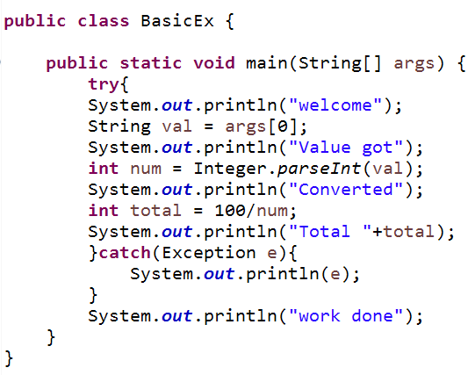
Example for try – catch :

Slide 41
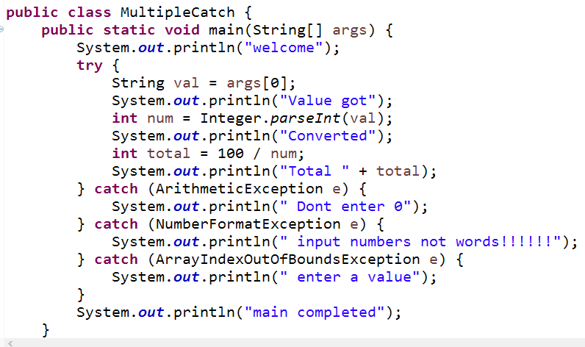
Example for try-catch-catch

Slide 42
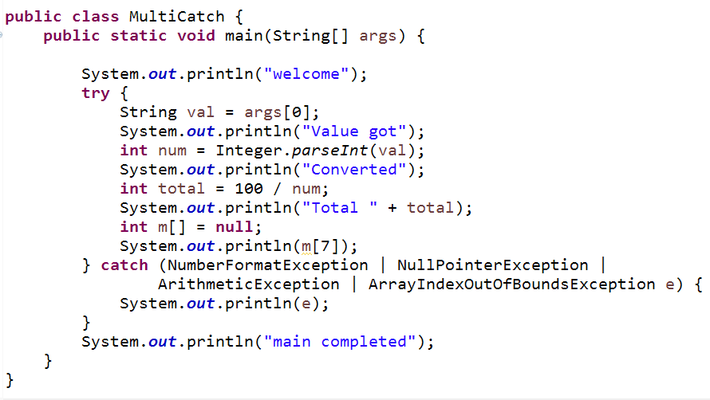
Multiple Catch
In multiple catch, the subclass exceptions must come before any of their superclass exceptions
If a catch statement uses a superclass exception first, it will catch exceptions of that type as well as exceptions of its subclasses so a subclass exception would never be reached that manifests as an unreachable code error

Slide 43
Finally :
Used for releasing resources(clean up code)
Will be executed for both cases, with exception or without exception
when exception occurs(try+catch+finally)
Statement after exception in try block will not be executed
A matching catch will be executed
All statements in finally executed
Statements after finally will also be executed
when exception occurs(try+finally)
Statement after exception in try block will not be executed
All statements in finally executed
Statements after finally will not be executed
Searches for a matching catch in the calling part.
If no catch is found JVM catches the exception

Slide 44
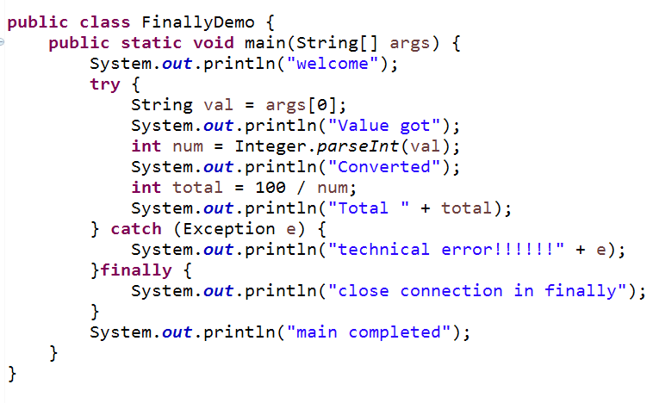
Example of try-catch-finally/try-finally :

Slide 45
Throw :
Is used to throw the exception to the place from where this method was called.
Is used if the exception should not handled in the current method, but thrown.
The general form of throw is:
– throw ThrowableInstance
where ThrowableInstance must be an object of type Throwable, or a
subclass of Throwable
eg. throw new ArithmeticException();

Slide 46
More on throw :
RuntimeException(Unchecked)
If a method throws runtime exception, you can either handle it with
try/catch or allow JVM to handle it.
CompileException(Checked)
If a method throws checked exception,
Declare the method with throws keyword
When you call this method call it within try/catch block
To allow JVM to handle it, declare the method which is calling also with
throws keyword

Slide 47
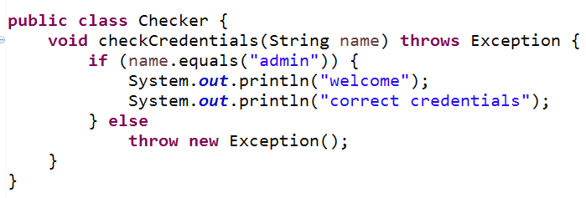
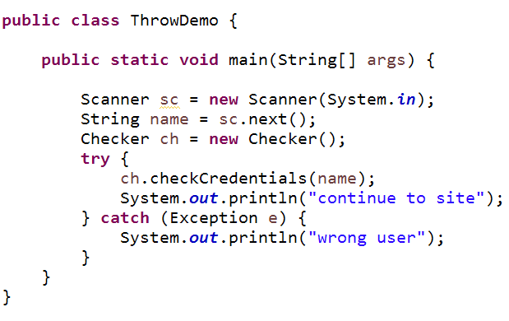
Example for throw :

Slide 48
Throws :
Is used to declare that the method throws exception
Mainly used for compile time Exception
Can throw one to many exceptions
eg. public void withdraw(int amount) throws IOException, Exception
When any method calls this method, it is mandatory
–to either call within try/catch block or declare this exception in the calling method or it will give compiler error

Slide 49
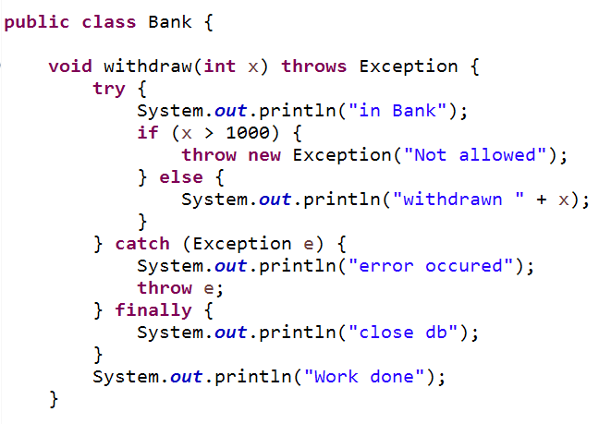
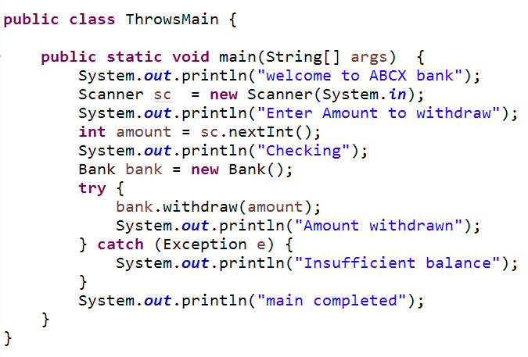
Example for throws :

Slide 50
Custom Exceptions :
Custom Exceptions are used for throwing project specific errors
Some examples can be like showing negative balance, age below the requiredlimit, taking Overdraft, checking password length etc
To create a custom Exception make a class that extends Exception class

Slide 51
Example for custom exception :
public class InvalidAgeException extends Exception {
public InvalidAgeException (String str)
{
// calling the constructor of parent Exception
super(str);
}
package com.lumen.exception;
public class TestCustomException1 {
// method to check the age
static void validate(int age) throws InvalidAgeException {
if (age < 18) {
// throw an object of user defined exception
throw new InvalidAgeException("age is not valid to vote");
} else {
System.out.println("welcome to vote");
}
}
// main method

Slide 52
Example for custom exception :
// main method
public static void main(String args[]) {
try {
// calling the method
validate(13);
} catch (InvalidAgeException ex) {
System.out.println("Caught the exception");
// printing the message from InvalidAgeException object
System.out.println("Exception occured: " + ex);
}
System.out.println("rest of the code...");
}
}

Slide 53
Rules for overriding Exception :
The overriding method must NOT throw checked exceptions that are new or
broader than those declared by the overridden method
eg: A method that declares(throws) an SQLException in super class
can be overridden only by a method that is a subclass of SQLException
if a method declares to throw a given exception, the overriding method in a subclass can only declare to throw the same exception or its subclass
This rule does not apply for unchecked exceptions

Slide 54
Try with resources :
This technique helps to close the resources automatically, after the
application gets completed.
Using try-with-resources eliminates the task of adding finally to close resources
Example for a resource: A file or a connection object or a scanner object.
Any class that implements java.lang.AutoCloseable or java.io.Closeable is considered as a resource and can be used with try-with-resources construct.

Slide 55
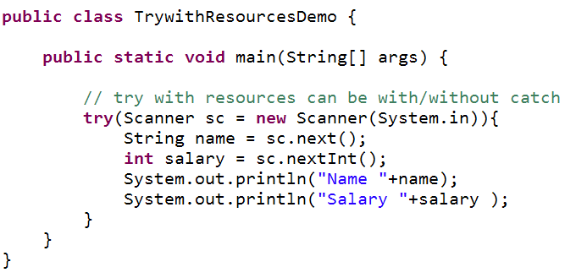
Try with resources :

Slide 56
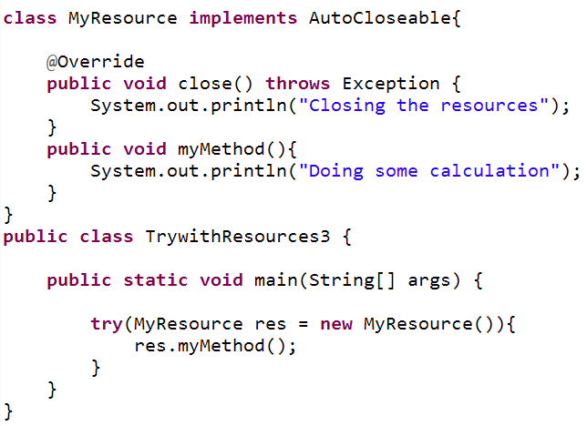
Example for try with resources:
MyResource is a class which implements AutoCloseable and overrides
close() method.
myMethod() is the method of MyResource class

Slide 57
java.lang

Slide 58
Contents:
Object
Wrapper classes
Conversions
String
StringBuffer
String Builder

Slide 59
Few classes in Lang Package :
Object
Math
String
StringBuffer
StringBuilder
Throwable
Exception
Thread
All Wrapper classes(eg.Integer,Float )
Runtime
Runnable
Comparable
Cloneable

Slide 60
Object:
Is the top level class.
All the classes extend this.
Has few methods
hashcode() and equals() → in util for Set
clone()
getClass() → with reflection
wait(),notify() and notifyAll()
finalize() → garbage collection
toString()

Slide 61
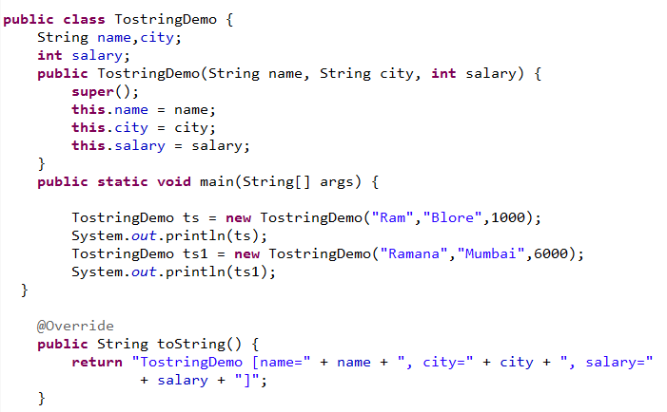
Use of toString() :
While printing an object will get hashcode value.
Override toString() method to get a proper output
Used by Exception classes

Slide 62
Cloning :
Is creating a copy of the original object.
Is field by field copy
Cloned object has separate memory address
Types of cloning supported by Java
Shallow Cloning
Deep Cloning
Steps in cloning
Class must implement Cloneable
Class must override clone method
No constructor is called on the object being cloned.

Slide 63
Shallow Cloning :
default implementation in java.
If you are not cloning all the object data types (not primitives), then it is a shallow copy
If the class has only primitive data type members,
then a completely new copy of the object will be created
the reference to the new object copy will be returned.

Slide 64
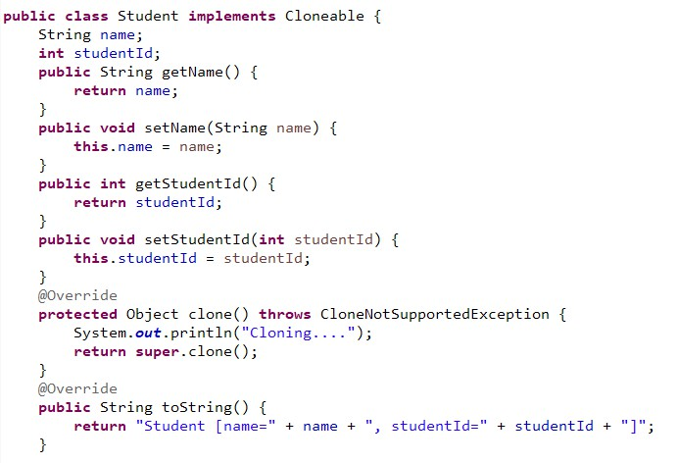
Student.java

Slide 65
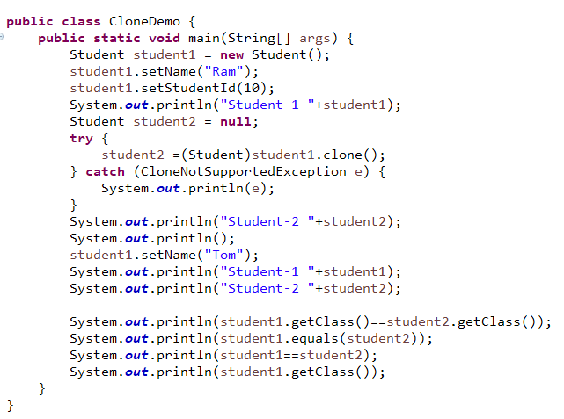
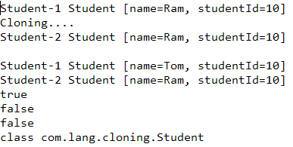
CloneDemo.java
Output

Slide 66
Hashcode and equals :
Every object has access to the equals() method because it is inherited from the Object class.
Default implementation compares the memory addresses of the
objects.
A class can override the equals() method from Object class.
In this case, the class should also override hashCode().
Else a violation of the general contract for Object.hashCode will
occur

Slide 67
Contract :
If two objects are equal according to the equals(Object) method, then calling the hashCode() method on each of the two objects must produce the same integer result.
It is NOT required that if two objects are unequal according to the equals(Object) method, then calling the hashCode() method on each of the two objects must produce distinct integer results.
Condition | Required | Not required (but allowed)
x.equals(y) == true | x.hashCode() ==y.hashCode()
x.hashCode() == y.hashCode() |  | x.equals(y) == true
x.equals(y) == false |  | No Hashcode requirements

Slide 68
Wrapper Classes :
Wrapper classes are inbuilt classes which convert the primitive data types into objects.
All the methods of the wrapper classes are static.
Wrapper classes
Boolean
Byte
Short
Integer
Long
Double
Float

Slide 69
Conversions :
String to Primitive Data Type
PDT to String
PDT to Object
Object to PDT
String to Object
Object to String

Slide 70

String to PDT :
xxx value = XXX.parseXXX(String a);

Slide 71
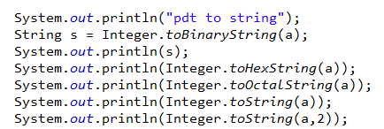
PDT to String :
Has static Methods only.
String s = XXX.toString(pdt);

Slide 72
PDT to Object- Autoboxing :
Used to wrap a primitive data to Object
Using AutoBoxing
int x =10; Integer y = x ;
System.out.println (“y = ” + y ) ; // Integer Object

Slide 73
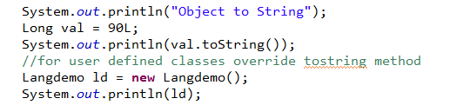
Object to String :
String value = instancevariable.toString();

Slide 74
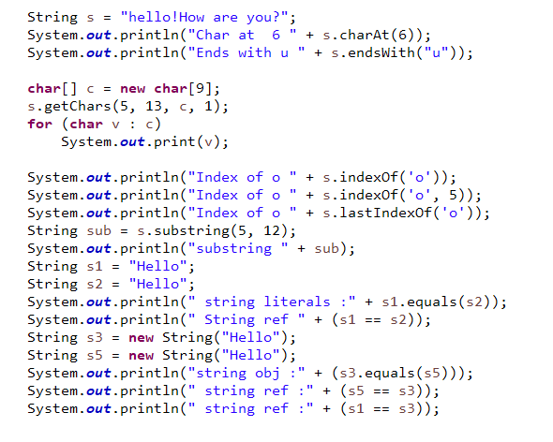
String :
This class represents character strings.
An immutable sequence of characters.
Can’t use insert, append, delete methods in a String object

Slide 75
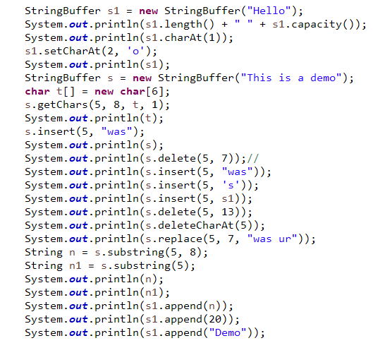
StringBuffer:
A mutable sequence of characters.
StringBuffer methods are synchronized, so it isthread safe
Can be used with multiple threads.

Slide 76
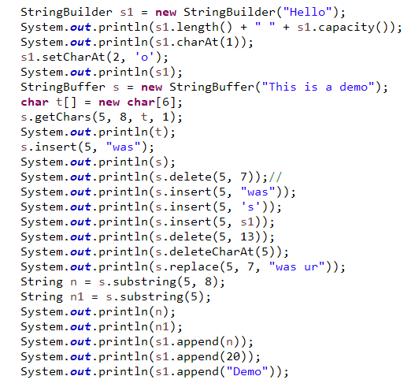
StringBuilder:
A mutable sequence of characters.
An API similar to StringBuffer.
StringBuilder methods are not synchronized, so not thread safe
Cannot be used with multiple threads. is faster

Slide 77
Java Util

Slide 78
Contents:
Collection Framework – an Overview
List
Set
Map
Example for functional Interfaces

Slide 79
Collection Framework:
Java collections framework (JCF) is a set of classes and interfaces that implement commonly reusable collection data structures
JCF provides both interfaces that define various
collections and classes that implement them.
Allows collection of objects to be treated as single unit
From java.util package
A collection is a group of objects called elements
Collections may be ordered or unordered or sorted
Some Collections accept duplicates while some do not
Collection Framework has:
Interfaces: abstract data types representing collections.
Implementations: concrete implementations of the collection interfaces. They are reusable data structures.
Algorithms: methods to perform useful computations, like searching
and sorting on objects that implement collection interfaces.

Slide 80
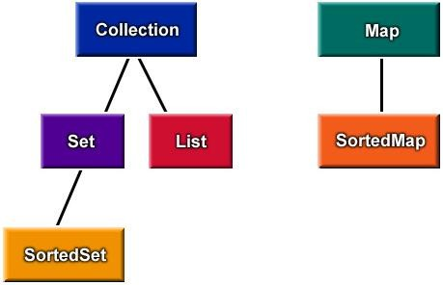
Interfaces:
The core collection interfaces that are used to manipulate collections, and to pass them from one method to another.

Slide 81
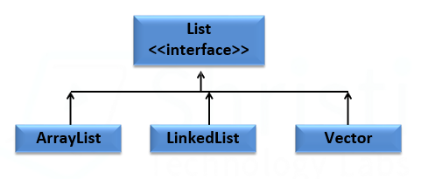
List :
Is an ordered collection
Elements can be added or removed by index
Behaves like a variable-size array
Order of the items is well defined as they are added by index
Allows positional access of elements
Classes that implement List
ArrayList
LinkedList
Vector

Slide 82
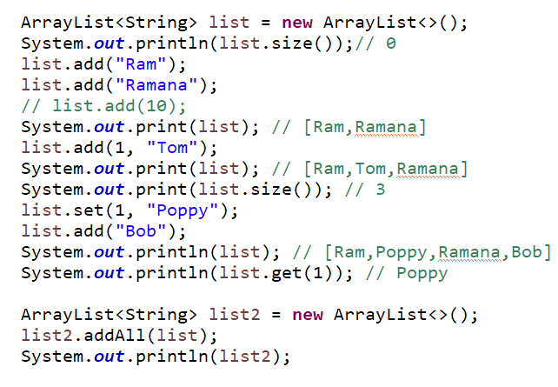
ArrayList :
ArrayList class provides resizable-array
Is an ordered collection and implements List interface
Allows duplicate elements including null.
eg.

Slide 83
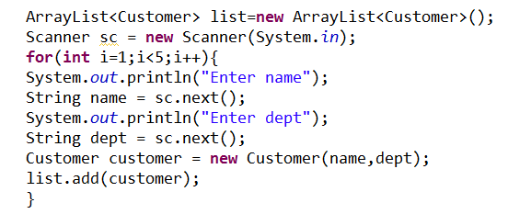
Example adding Customer objects:

Slide 84
Iterator and ListIterator:
Is used to access the elements of collection object in sequential manner without knowing its underlying representation.
Are interfaces based on Iterator design pattern
Iterator is only for forward access
ListIterator can iterate the elements in both forward and backward
Direction
iterator() method is used to return an iterator over the elements.
public Iterator<E> iterator()
Methods in Iterator Few Methods in ListIterator
boolean hasNext() E next()
void remove()
boolean hasNext() E next()
void remove()

Slide 85
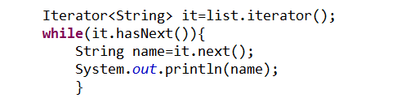
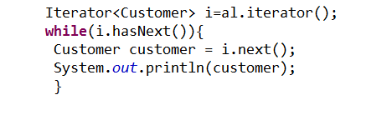
Example for Iterator:
For String objects
For user defined(Customer) objects

Slide 86
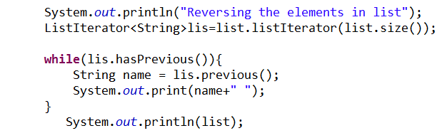
Example for ListIterator for reversing the list:

Slide 87
LinkedList :
LinkedList is an ordered set of data elements, each containing a link to its successor and sometimes its predecessor
Each node points to next node by a pointer.
Implements List and Queue interface
Elements can be added in front or at the end of a collection
Can be used for faster insertion

Slide 88
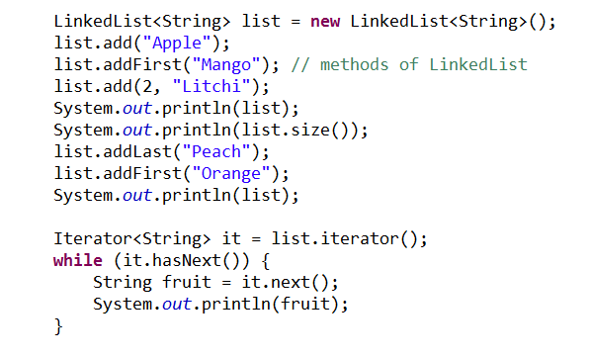
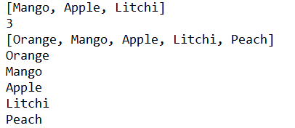
Example for LinkedList:

Slide 89
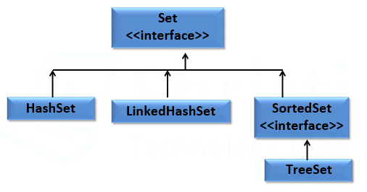
Set :
Is a type of collection which does not accept duplicates
Has both unordered and sorted collection
Adds a stronger contract on the use of hashcode and equals method.
This allows set instances to be compared meaningfully even if their
implementation types differ.
Classes that implement Set
HashSet
LinkedHashSet
TreeSet

Slide 90
HashSet :
HashSet class implements the Set interface, backed by a hash table.
Makes no guarantees in the iteration order of elements.
Allows null element.
HashSet methods are not synchronized
Unordered Collection

Slide 91
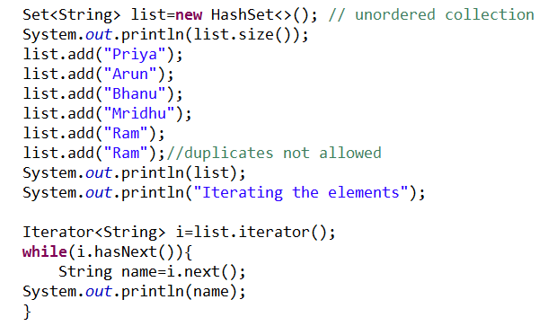
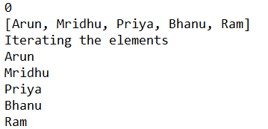
Example for Hashset :

Slide 92
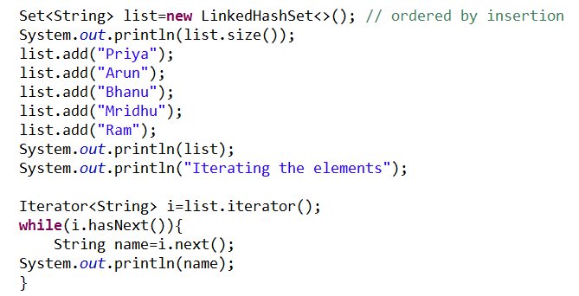
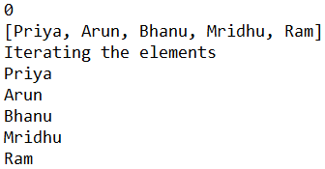
LinkedHashSet :
LinkedHashSet class implements the Set interface, backed by a hash table.
Is implemented as a hash table with a linked list running through it
Orders its elements based on the order in which they were inserted into the set (insertion-order).
Ordered by insertion

Slide 93
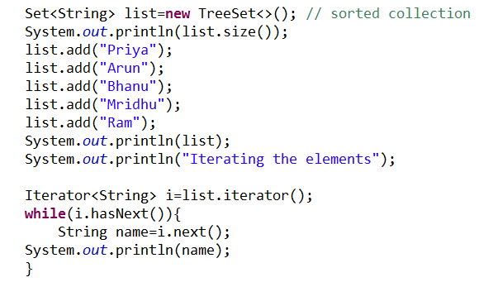
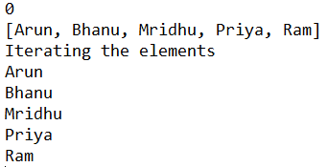
TreeSet :
TreeSet class implements the SortedSet interface
Elements are ordered using their natural ordering or by a Comparator provided by Set during creation time
Slower than HashSet
Does not allow null elements(throws NullPointerException)
Does not allow non-compatible elements(throws ClassCastException)
Sorted Collection

Slide 94
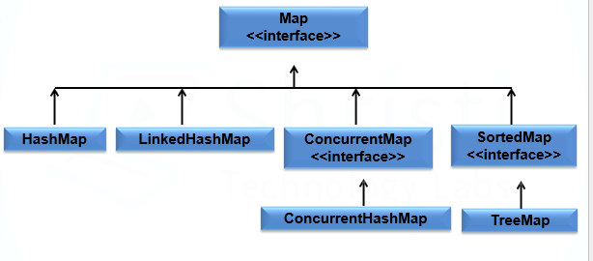
Map :
Stores an association or mapping between "keys“ & "values"
A Map is used as an object that maps keys to values.
Cannot contain duplicate keys
Each key can map to at most one value.
Classes that implement Map
HashMap
LinkedHashMap
TreeMap

Slide 95
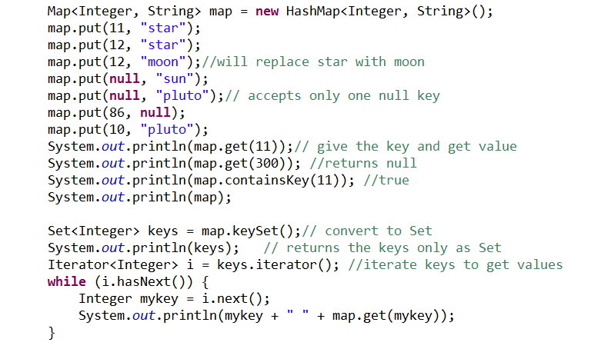
HashMap :
Is a data structure that can map key to values
Uses a hash function to compute an index into an array of buckets
or slots, from which the correct value can be found.
The elements in the map are added as per the hashcode values of the keys.
Accepts one null key

Slide 96
ConcurrentMap :
Can be used safely in concurrent and multithreading applications
Is capable of handling concurrent access (puts and gets) to it.
Does not lock the Map while reading from it, locks only a part of it during updates
Does not lock the entire Map when writing to it, locks only the part of
the it that is being written to, internally.
ConcurrentHashMap
is the implementation of ConcurrentMap
Does not accept null key and null value
Allows to modify the map during iteration

Slide 97
Comparable :
Is an interface from java.lang
Is implemented by a class in order to be able to compare object of itself with other object of same class.
Used only when you need one sorting sequence
Rules
The class itself must implement the interface
Implement compareTo(Object o) method.
Call Collections.sort(List list) method to sort the collection

Slide 98
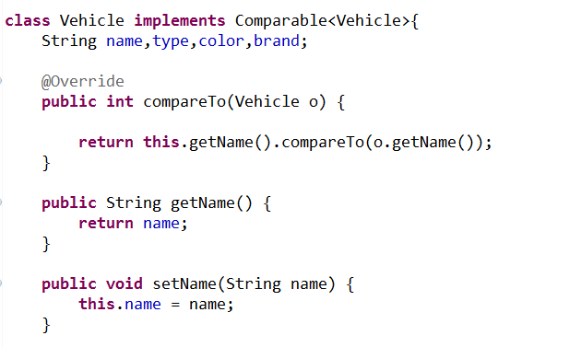
Example – implementing Comparable :

Slide 99
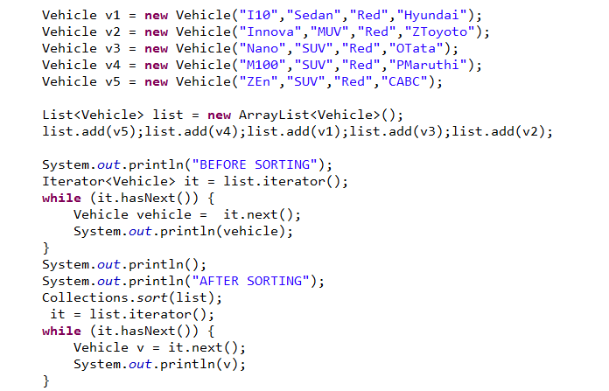
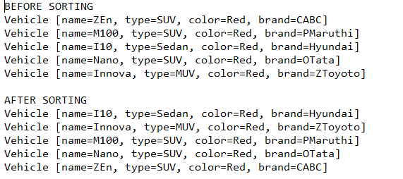
Example – calling sort() method :

Slide 100
Comparator:
Is an interface from java.util
Used to compare objects based on certain attributes/fields.
Used when multiple sort sequences are needed.
eg. One user might want to sort vehicles by price, one user by name, one by brand – not possible by Comparable as it allows only one sorting
Create separate classes for different sort sequence.
Rules
Create a separate class that implements Comparator
Implement compare(Object o,Object o1).
Call Collections.sort( List obj, comparator obj) method to sort the collection

Slide 101
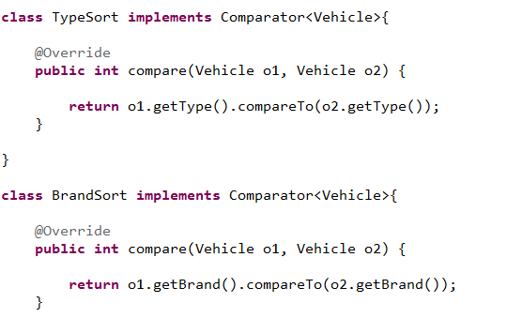
Example - implementing Comparator :

Slide 102
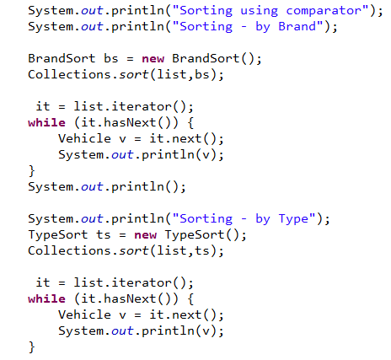
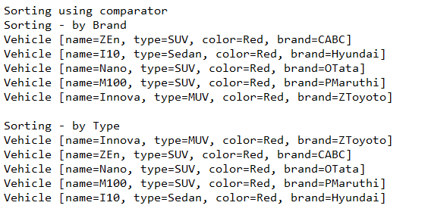
Example - using sort() method :

Slide 103
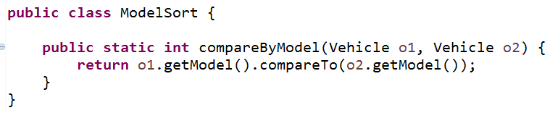

Using Method references - static :

Slide 104
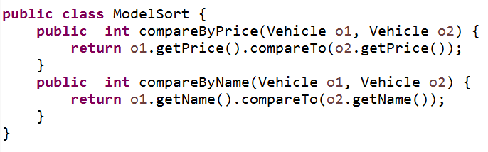

Using Method references - instance :

Slide 105
Thanks

